Slide 1
Movie Analysis
Phase 1 Project
Wambui Mutero – Part Time

Slide 2
Summary
Provide a concise summary of your project and ﬁndings here ;
The objective of this project is to study different datasets and analyze with concrete findings how to put Microsoft on the map of the movie industry.
This project will use Exploratory Data Analysis to generate insights for Microsoft. Three datasets were used : Box Office Mojo, IMDB ratings and IMDB basics.
The datasets were imported, data described, missing values identified, the values were then filled with appropriated values and later visualization took place which provided concrete analysis that would help to kick start the new venture Microsoft would want to get in on.

Slide 3
Outline
Business Problem
Data
Methods
Results
Conclusions

Slide 4
Business Problem
Describe the business problem here;
The Business problem that this project wants to solve is that Microsoft have no experience or understanding of the movie and field industry. They are looking for and gathering data insights and recommendations that will help them come up and create a new movie studio.
Hence the task at hand is using the actionable insights to help them know and decide on what type of films to create.

Slide 5
Data
Describe relevant characteristics of your data here ;
The data loaded and then imported to my notebook was of csv.gz type of file.
The data obtained was described and summarized by two approaches :Quantitative approach describes and summarizes data numerically and The visual approach illustrated the data with plots, histograms, and other graphs.
I described and summarized the datasets using two variables, hence undertaking a bivariate analysis.

Slide 6
Methods
Describe the methods you used here. Can include data preparation, analysis, and/or modeling;
Data preparation followed a series of steps
-Collecting data is the process of assembling all the data you need . Our data resided in the cloud which I then needed to import to my local computer.
-Cleaned data, corrected data and filled in missing data as a step to ensure data quality.
-Visualized the new and improved data with labels for a better understanding.

Slide 7
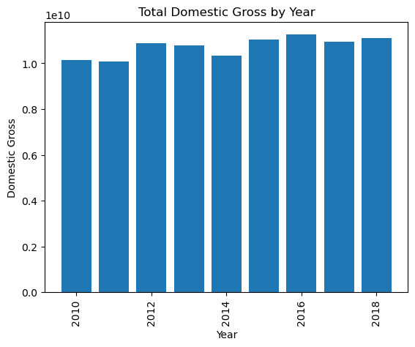
Results
Present the results of your analysis or modeling here. Should include evaluation of how well your results solve the business problem.
*The bar graph showed here is a case of two variables ; the domestic gross plotted against the years of movie production from the Box Office Mojo dataset.
*There was a notable progression over the years from 2010 – 2018 of the total domestic gross. Films were getting more and more recognized hence many people were interacting with them more over the years.

Slide 8
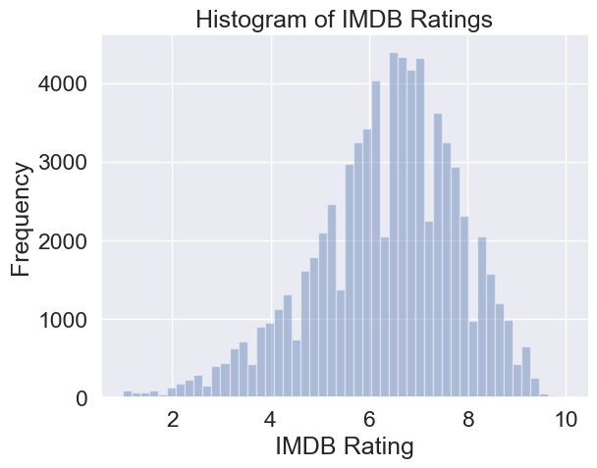
*The second dataset was between two variables: the frequency which was obtained by getting the average, plotted against the IMDB ratings.
*The histogram indicates that the highest ratings on IMDB are more prevalent in the 7 point mark, which is ideally above average.
*The frequency in the above example refers to the number of occurrences of a particular IMDB rating value in the averagerating column of the data.

Slide 9
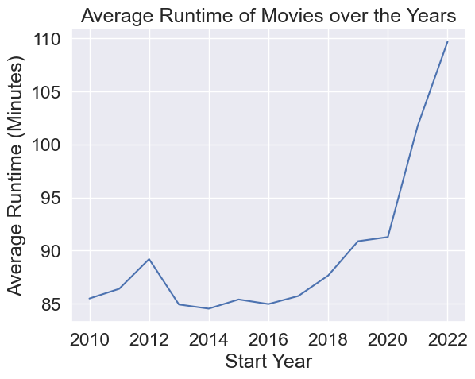
*The third dataset is visualized by a line graph showing the average runtime of movies in the IMDB dataset over the years.
*In 2010 it starts steadily and spikes up until 2012 and then there’s a sudden plummet and then it plateaus for a bit. It then shoots up recording the highest all time average runtime in 2022.

Slide 10
Conclusions
Present your conclusions about the project here. Can include business recommendations, project limitations, and/or future improvement ideas;
*For the first data set used we found out that: increased in Box Office Mojo as the years progressed. The films were getting more and more recognized hence many people were interacting with them more over the years. This can seemingly explain: - At the beginning the interaction with the movie studio is slow, but as people get to know and experience Box Mojo their user interaction increased as well. - The total gross income increases steadily and is highest in the year 2018.
-A business recommendation based on the insights obtained: The business will start slowly as it steadily grows both in monetary value as well as being consumed.
* For the second data set we obtained, we were getting the IMDB ratings of the different films. Most of the films are at the 7.0 point mark which is above average. This indicates that the movies being rated by IMDB are considered good. This is shown by the frequency of the number of votes casted to the consumers.

Slide 11
*For the final dataset it showcases the average runtime calculated against the years. As the years progressed there was an increase in runtime. This can be due to a couple of factors:
- Increased move knowledge and production competency over the years to produce longer movies with more screen time to wow the consumer.
-Understanding the momentum it takes for a movie to have a perfect based storyline.
-Having the best people in the movie industry directing and producing the movies.
*Microsoft can identify great people in the industry who they can bring into the team and who can help transform and give an experienced perspective of the movie industry which will then put them at a better and gaining position.

Slide 12
Thank You!
Email: gloria.mutero@student.Moringaschool.com
GitHub: Wambui0001

